Slide 3
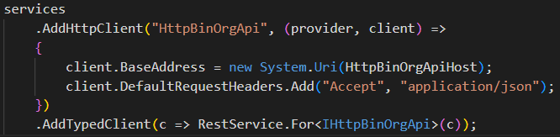

Slide 4
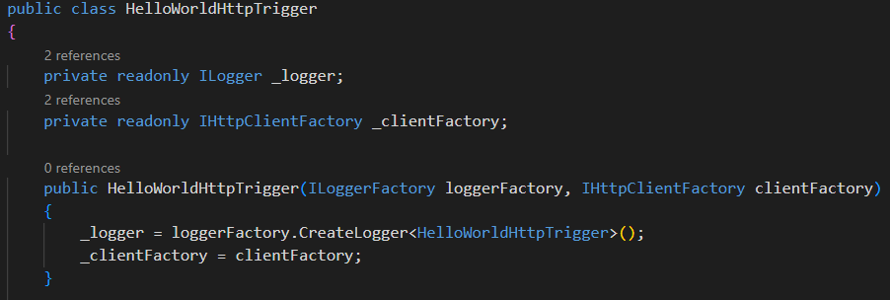
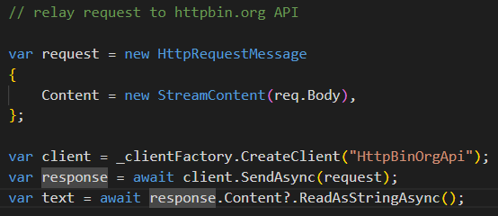
AddHttpClient(string name, IServiceCollections services);

Slide 5
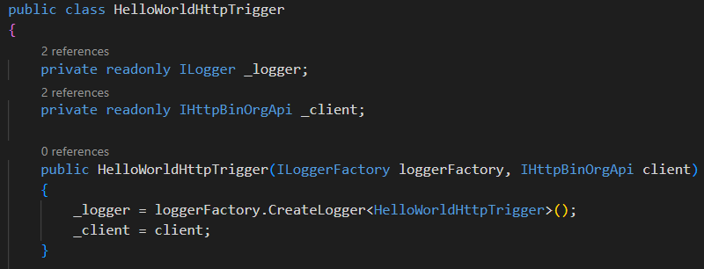
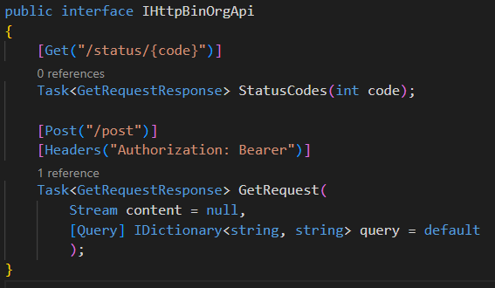
AddTypedClient(c => RestService.For<IHttpBinOrgApi>(c));

Slide 6
HttpClient handlers pipeline

Slide 7
Using HttpClient handlers to mock HTTP calls

Slide 8
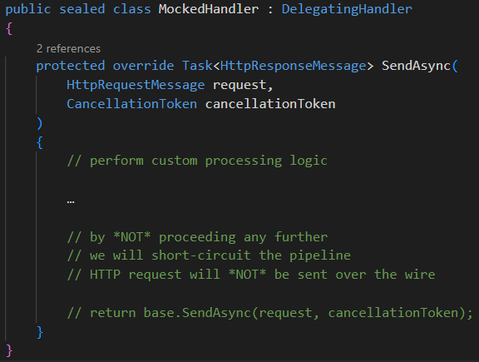
Using HttpClient handlers to mock HTTP calls

